Slide 1

02
FUNGI
KIT
Programming Guide

Slide 2


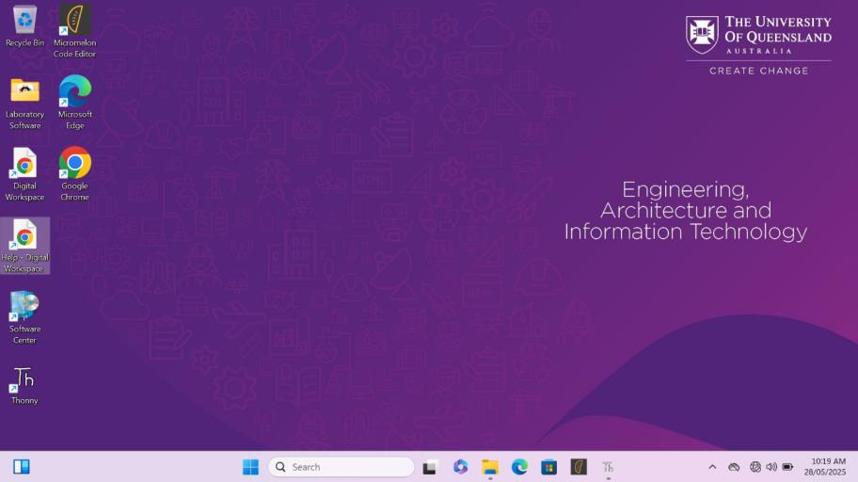
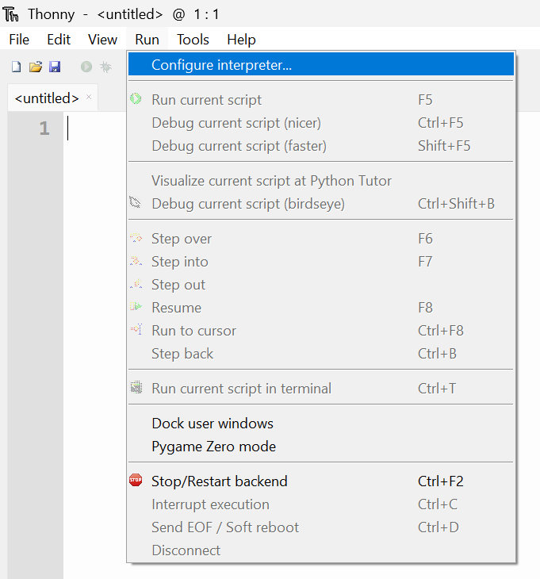
Fungi Kit Programming Guide
Step 1: Opening Thonny
To program the microcontroller, you will be using a program called Thonny. Open the program by double clicking on the shortcut on the desktop or clicking on the taskbar icon to open it.
fig. 1
Once Thonny is open, go to the top toolbar and select Run > Configure Interpreter...
fig. 2

Slide 3
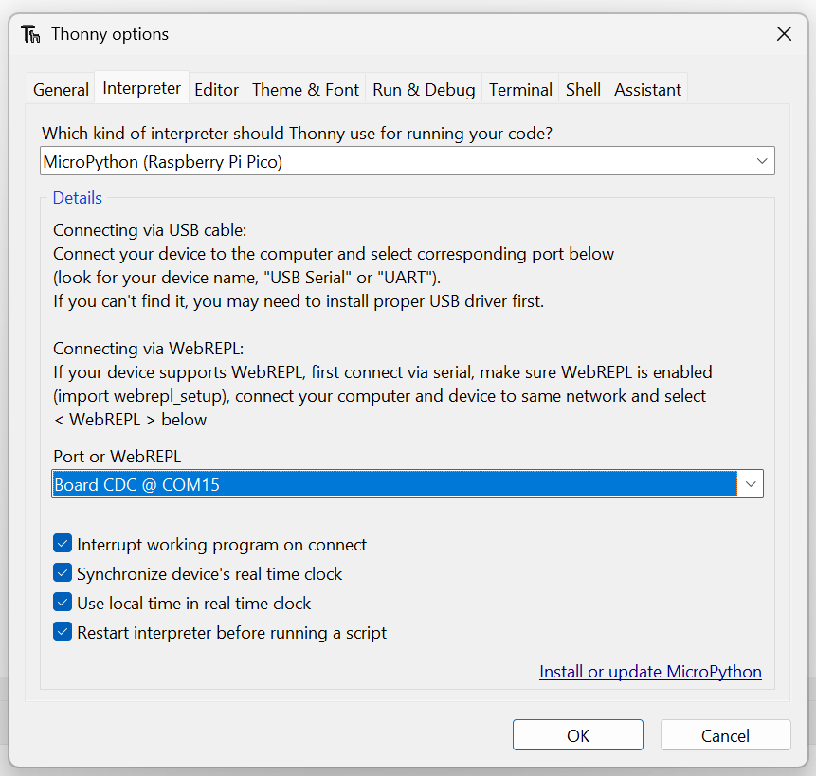
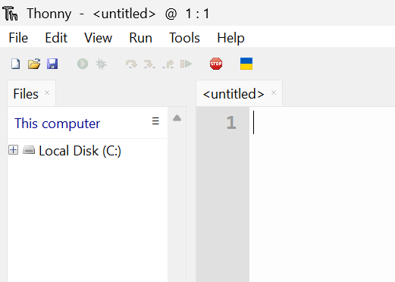
Fungi Kit Programming Guide
Step 2: Connecting to the Raspberry Pi Pico
In the second dropdown, select Board CDC @ COM (note: your number may be different).
If you do not see Board CDC @ COM, select < Try to detect port automatically >.
⚠️
fig. 3
Click OK.
Then press the red Stop button (red stop sign) at the top left of the Thonny window. This will tell Thonny to find the Raspberry Pi Pico.
fig. 4

Slide 4
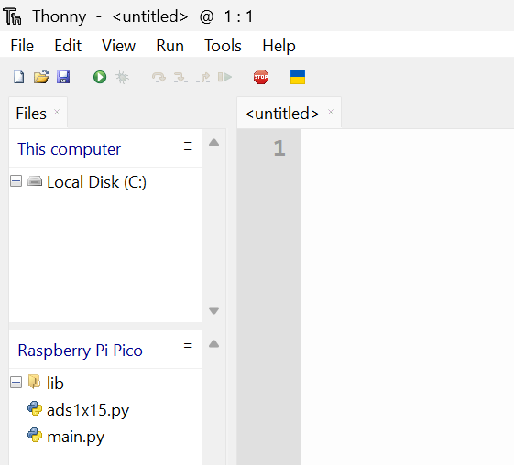
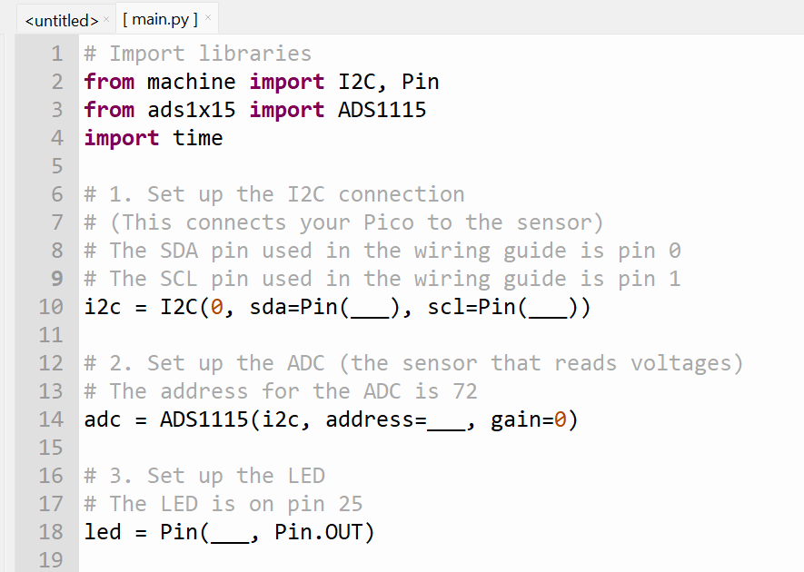
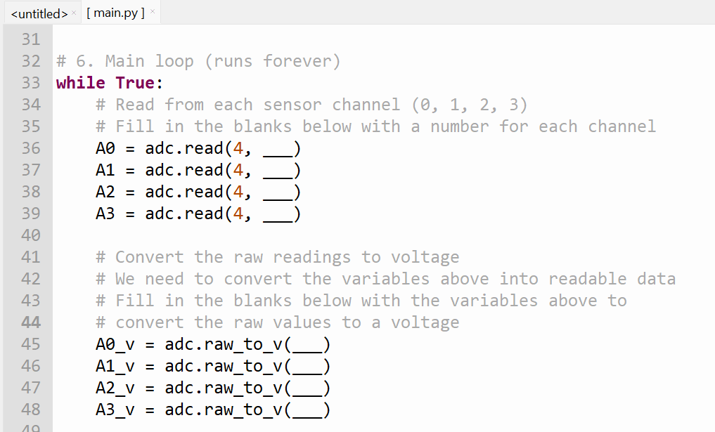
Fungi Kit Programming Guide
Step 3: Opening the Code on the Raspberry Pi Pico
You should now see a section in the Files panel on the left named Raspberry Pi Pico.
Double click on the main.py file to open it.
fig. 5
Step 4: Filling in the Code
Now, look through the code and fill in the missing blanks (where you see ‘___’)
Read the comments above each for hints on what to input
fig. 6

Slide 5
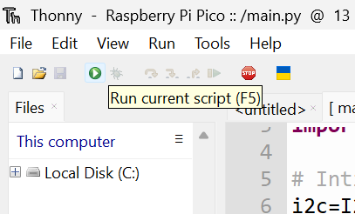
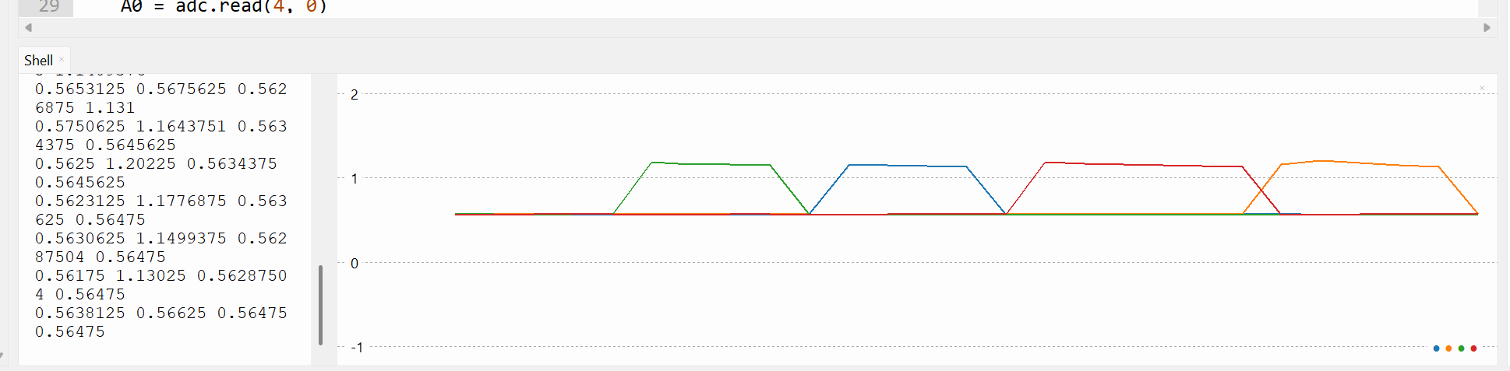
Fungi Kit Programming Guide
Step 5: Running and Testing the Program
Click the Green Play Button in the top left corner of Thonny to start the program.
fig. 7
If successful, you will see:
Readings print to the Shell at the bottom Thonny.
A graph being plotted in real time.
The LED blinking once every second
A file created in the left Files tab called “data.csv”.
Try touching each wire from the ADC with your fingers and observe how it affects the data shown in the plot.
fig. 8

Slide 6
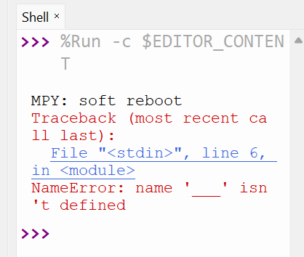
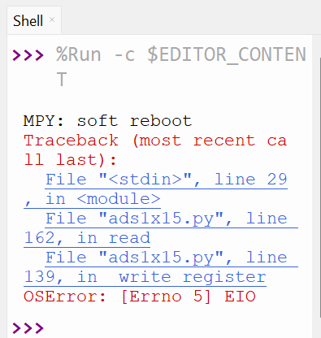
Fungi Kit Programming Guide
Troubleshooting
⚠️
If you see the error below in your Shell, it means you missed one of the blanks to fill in.
fig. 9
⚠️
If you see this error below in your Shell, double check your wiring. This indicates the Raspberry Pi Pico cannot read from your ADC.
fig. 10
⚠️
If you are still having problems, ask for help from a tutor.

